Slide 1
PHOTO EDITING - Development
CSE 611 – MS Project Development
Professor – Jinjun Xiong

Slide 2
TEAM MEMBERS
Pavana Lakshmi Venugopal
Saad Ahmed
Taraka Rohit Adusumilli
Ayesha Humaera

Slide 3
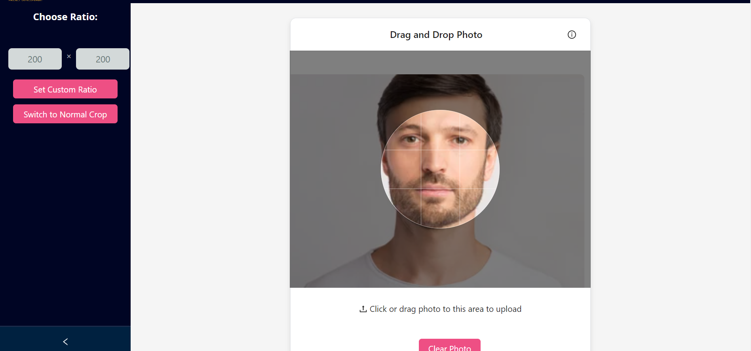
Circular Crop

Slide 4
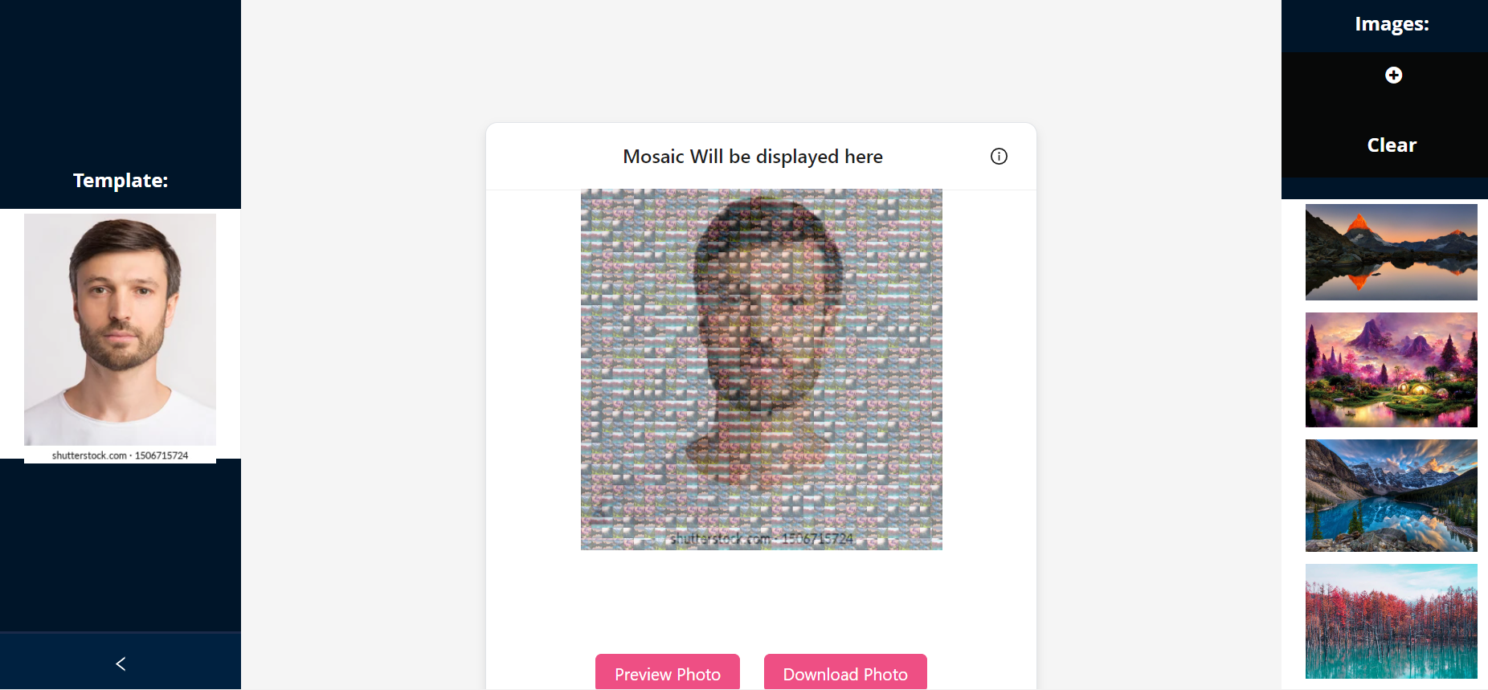
Updated Mosaic Feature

Slide 5
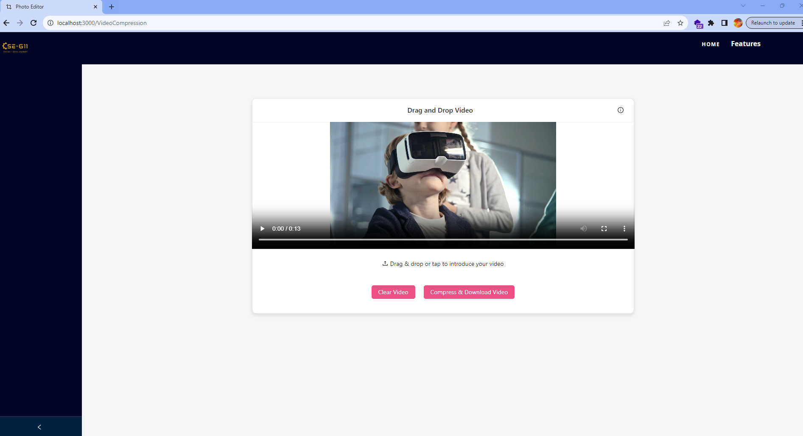
Video Compression

Slide 6
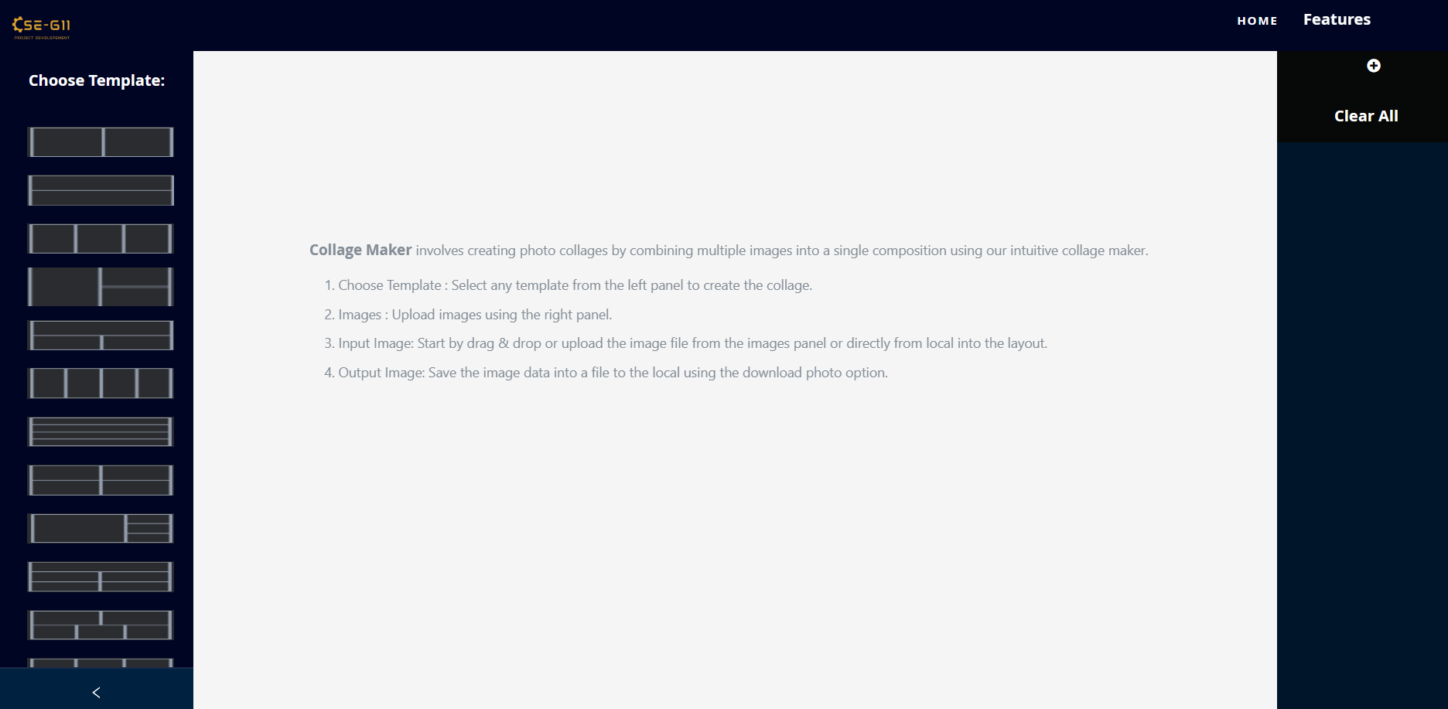
Collage Page - After Modernization and Fix (Added Visual Cues and Fixed Sliders)

Slide 7
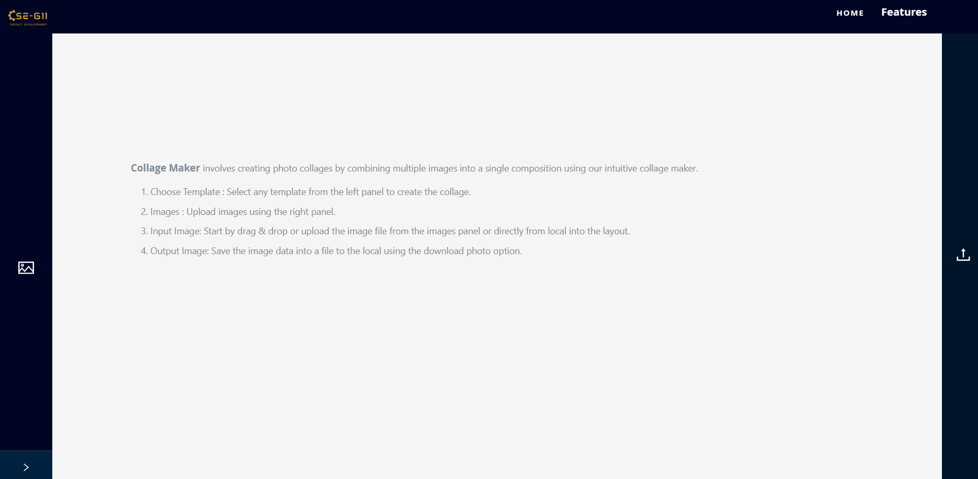
Collage Page - After Modernization and Fix (Added Visual Cues and Fixed Sliders)

Slide 8
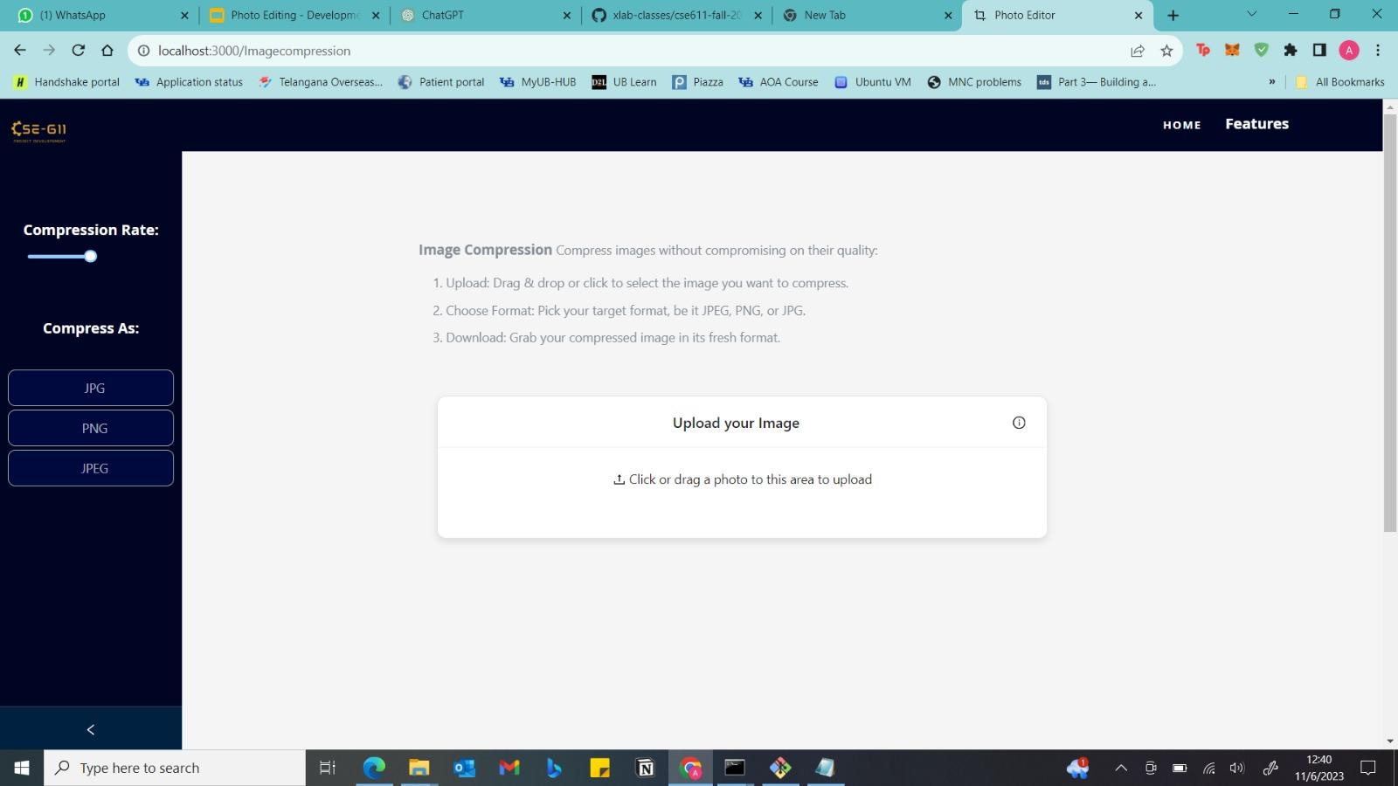
Image Compression - After Modernization (Added Compression Rate Slider)

Slide 9
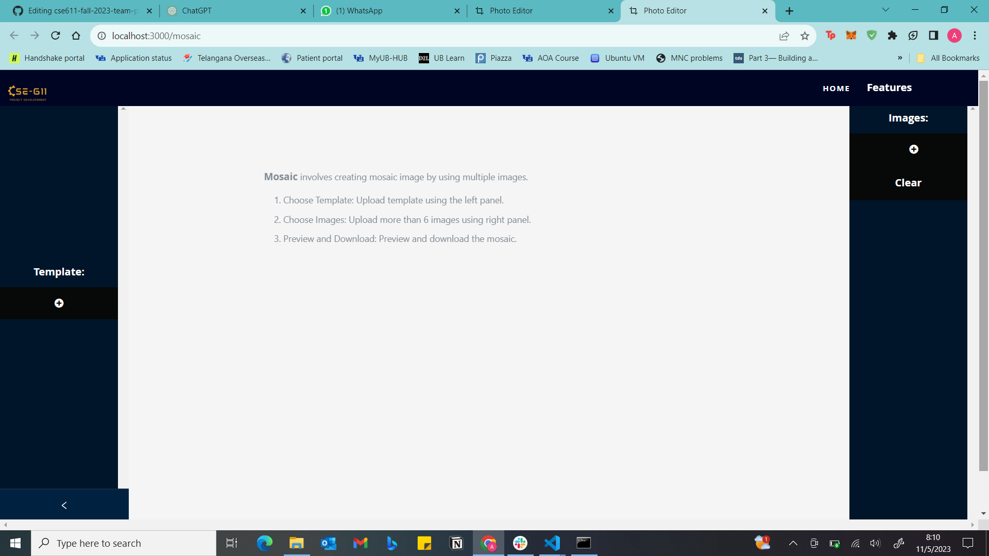
Mosaic page - Before Fix

Slide 10
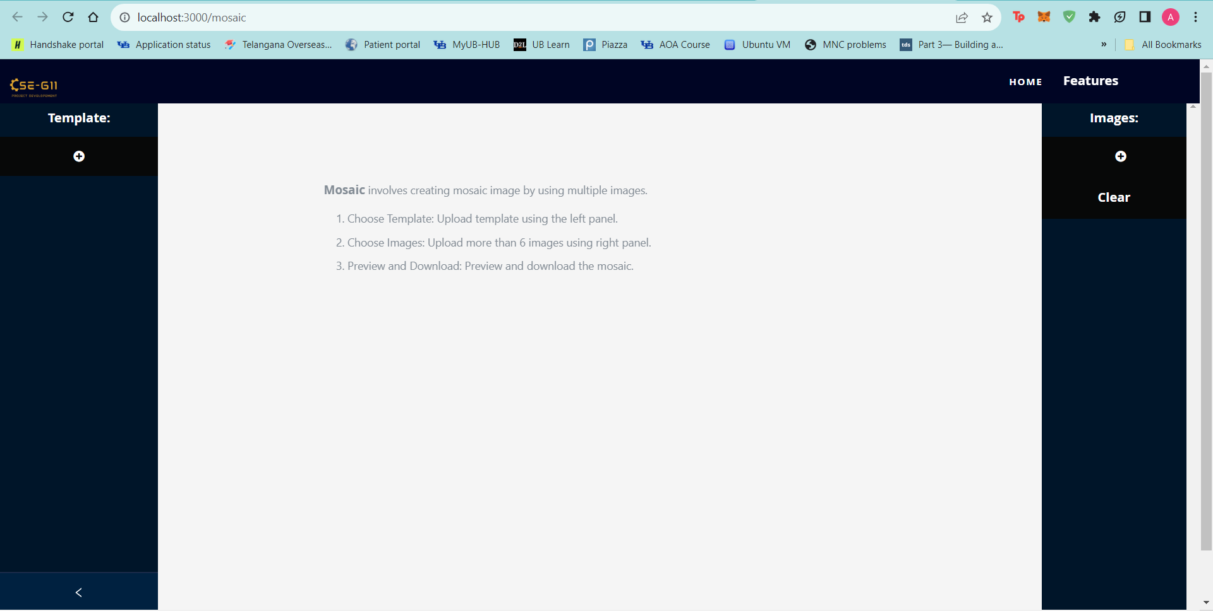
Mosaic page - After Fix

Slide 11
Thank you

